Slide 1
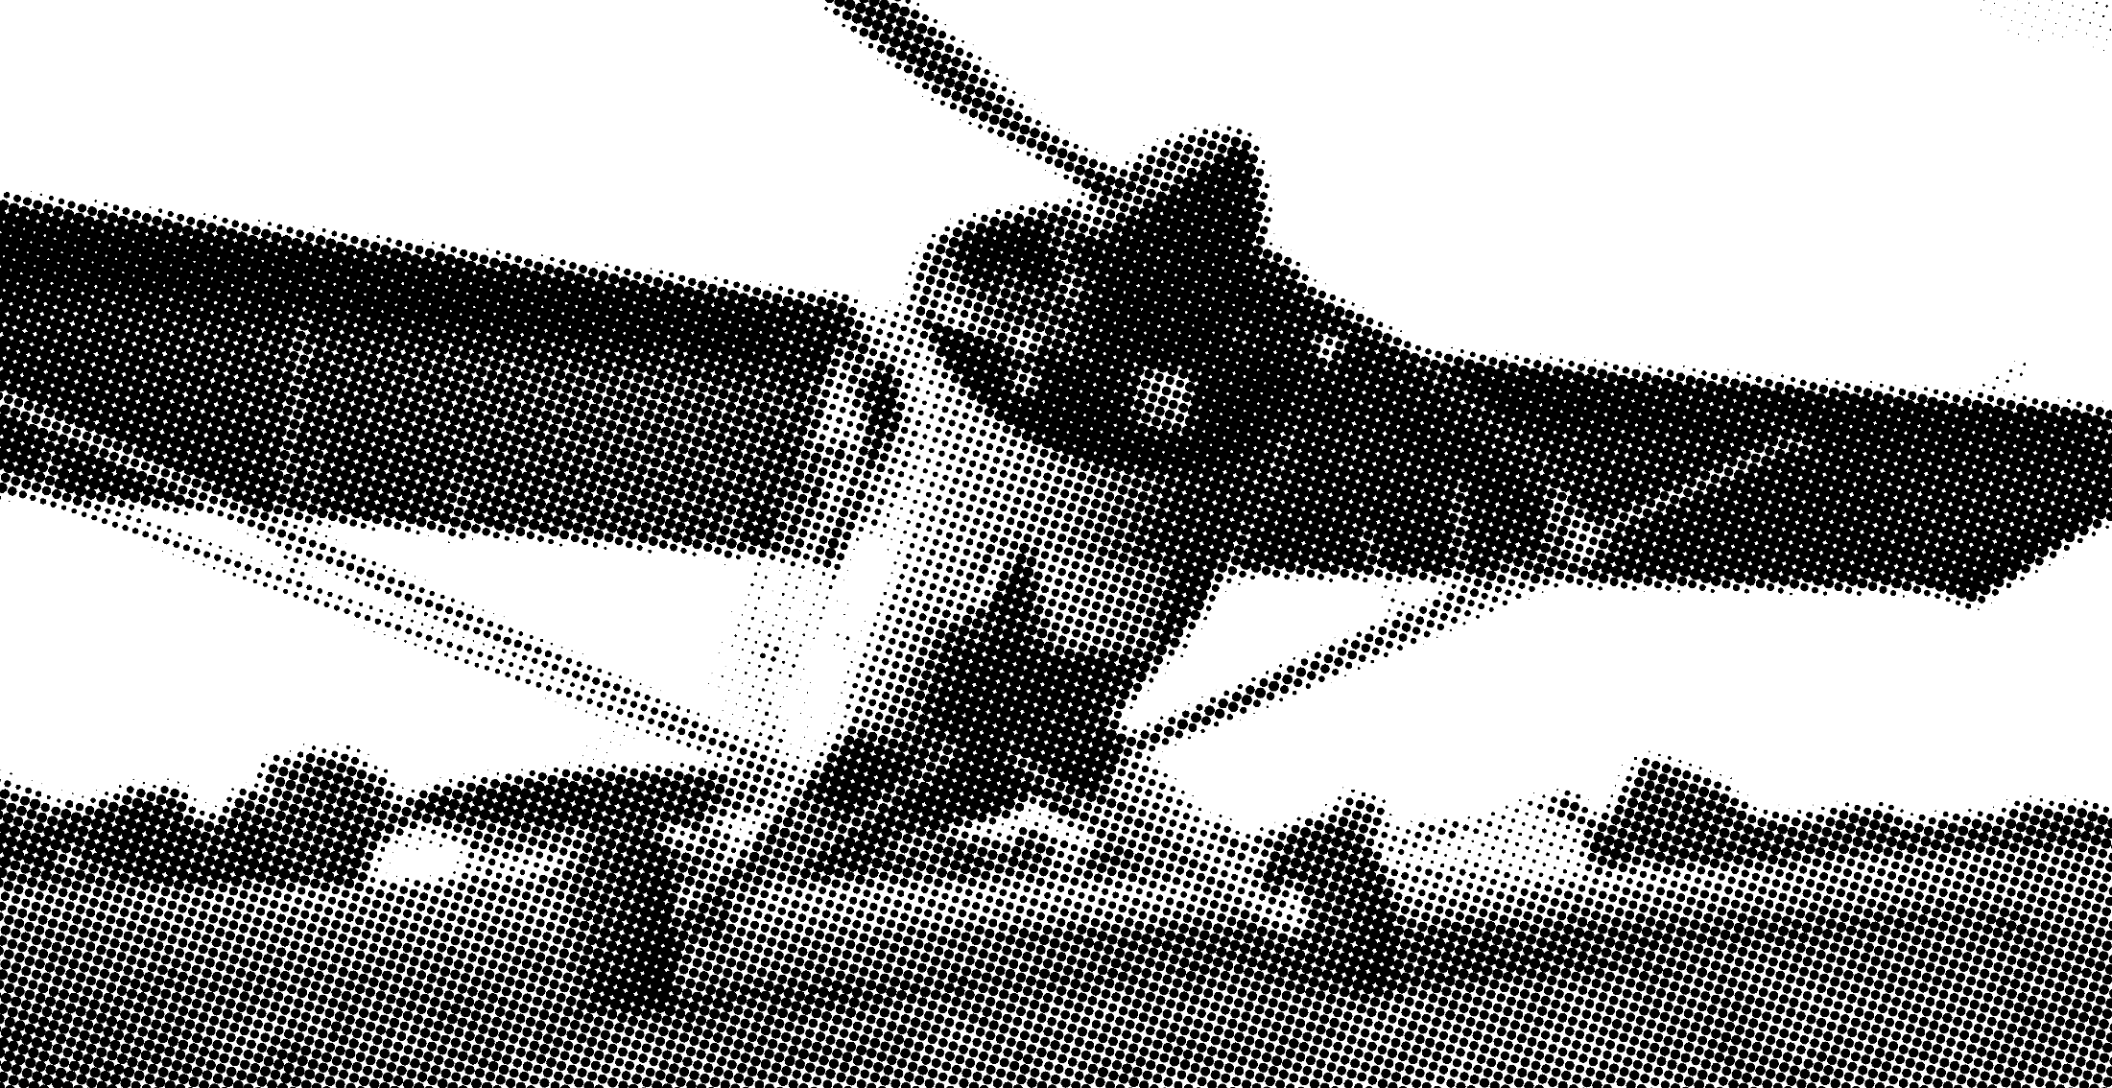
Secretaries Report
IAOPA
29th World Assembly Update
Secretary General

Slide 2

Secretaries Report World Assembly Update
IAOPA Secretary General
  IAOPA continues to grow number of affiliates worldwide
    2016
      AOPA Moldova, 75th Affiliate
      AOPA Qatar, 76th Affiliate
      AOPA Indonesia, 77th Affiliate
      AOPA Costa Rica, 78th Affiliate
    2017
      AOPA Belarus, 79th Affiliate
      AOPA Belgium and AOPA Pakistan reconstituted
      Working with Kenya, Monaco, and Hungary on reconstitution

Slide 3
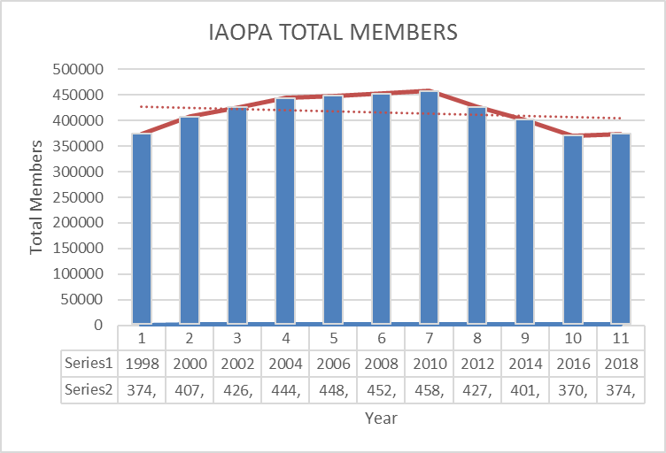
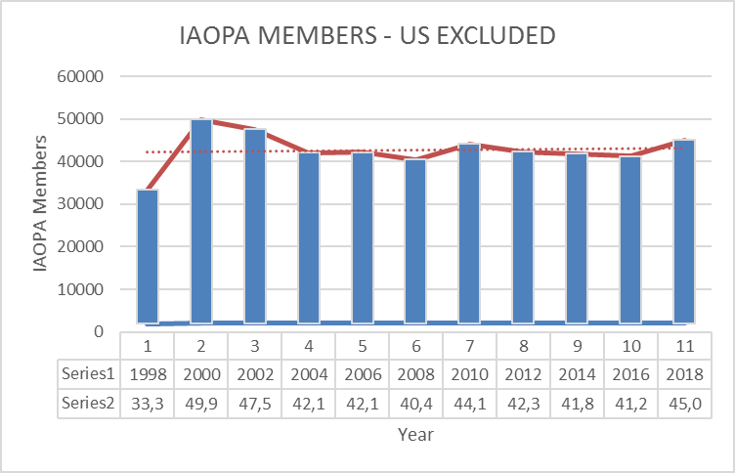
Membership
IAOPA Secretary General

Slide 4
Affiliate Leadership Changes
IAOPA Secretary General
  2016
    AOPA Belize: President – Max Heatherington
    AOPA Costa Rica (Provisional): President – Rafael Oreamuno (1st)
    AOPA France: President – Emmanuel Davidson
    AOPA Iceland: President – Haraldur Unason Diego
    AOPA Indonesia (Provisional): Chairman - Girardi Soejatman (1st)
    AOPA Israel: Chairperson – Nathan Sharon
    AOPA Lithuania: President – Mr. Benas Laurinaitis
    AOPA Malta: President – Chris Ebejer
    AOPA Moldova: President – Captain Andrei Baidetkl (1st)
    AOPA Namibia: President – Philip Ellis
    AOPA Norway: President: Tom Roren
    AOPA Qatar (Provisional): Chairman - Sheikh Mansoor Al-Thani (1st)
    2017
    AOPA Belarus: President – Alexandr Tsenter (1st)
    AOPA Belize: President – Brian Dueck
    AOPA Bulgaria: President - Dr George Ignatov
    AOPA‑Cyprus: President - Vasilis Koushappas
    AOPA-India: President - Col (Retd) Rampal Suhag
    AOPA Lithuania: President - Benas Laurinaitis
    AOPA Philippines: Secretary General – Gomeriano Amurao
    AOPA Saudi Arabia: Executive Director – Captain Ayed Alkasme
    AOPA-Slovenia: Chairman - Mihael Matevzic

Slide 5
Communications and Media
IAOPA Secretary General
  IAOPA Headquarters produced and distributed monthly newsletter
    Distribution to affiliates for retransmission to members.
    Affiliates post on Website for viewing
  Press Releases:
    AOPA Moldova
    IAOPA Rebranding
    AOPA Belarus
    EUROCAE MOU

Slide 6
Key Developments
IAOPA Secretary General
  IAOPA Regional Elections
  IAOPA Rebranding Continues
  IAOPA Europe MOU with EUROCAE
  Continued advocacy at ICAO, 39th World Assembly
  Increased activity with JARUS
  Billing automated
  European Regional meetings and work with EU Commission
  EASA General Aviation Roadshows
  IACO and European reports expand on work being accomplished

Slide 7
Key Developments
IAOPA Secretary General

Slide 8
Key Developments
IAOPA Secretary General
  IAOPA Regional Elections
  IAOPA Rebranding Continues
  IAOPA Europe MOU with EUROCAE
  Continued advocacy at ICAO, 39th World Assembly
  Increased activity with JARUS
  Billing automated
  European Regional meetings and work with EU Commission
  EASA General Aviation Roadshows
  IACO and European reports expand on work being accomplished

Slide 9
Key Developments - Rebranding
IAOPA Secretary General

Slide 10
Key Developments
IAOPA Secretary General
  IAOPA Regional Elections
  IAOPA Rebranding Continues
  IAOPA Europe MOU with EUROCAE
  Continued advocacy at ICAO, 39th World Assembly
  Increased activity with JARUS
  Billing automated
  European Regional meetings and work with EU Commission
  EASA General Aviation Roadshows
  IACO and European reports expand on work being accomplished

Slide 11
Way Forward
IAOPA Secretary General
  IAOPA Rebranding
  IAOPA Web upgrades
  Improve Regional Cooperation
    Grow Africa Region
    South America
    Improve communication
  Implement AOPA Global
  Automate record keeping and internal communications

Slide 12

Questions?
IAOPA Secretary General

